Slide 1


Lessons learned from building YARP
Sam Spencer
github.com/microsoft/reverse-proxy

Slide 2

Agenda
What is a reverse proxy
What is YARP
YARP Architecture
Demo
Platform Learnings & Improvements

Slide 3
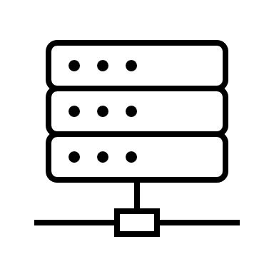








What is a reverse proxy
Public Internet
Private Network
contoso.com/orders
Reverse proxy
contoso.com/store
woodgrovebank.com
Acts as the public endpoint for the sites & services, or as a service mesh
Indirects calls to backend servers to perform real work, balancing load between them
Can offload work from backend servers: Encryption, Auth², Compression, Caching

Slide 4

What is YARP
Project to create an open-source reverse proxy using .NET
Layer 7 proxy – terminates & re-issues requests
Inbound and outbound connections are independent
Enables offloading of work to proxy from back end servers
Extensibility & customizability is key requirement
Configuration – static files, Dynamic via API or on-demand per request
Pipeline of stages for how requests are processed
Use existing ASP.NET middleware or create new
Plan to ship multiple form factors
Standalone proxy “exe” with config files
Library + template project to enable customization
Docker image

Slide 5
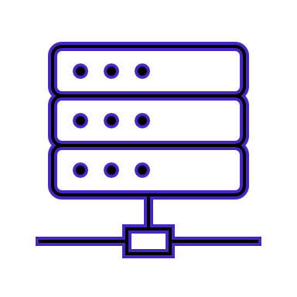


YARP Architecture
Proxy process
ASP.NET
TLS Termination
Kestrel
Proxy-er
http(s)
Destination Enumeration
Session Affinity
Load Balancing
Passive Health Checks
Request Transformations
http(s)
Static Files
Routing
Specific destination server
Auth²
HttpClient*
Other routes
Health
checks
Config
Notes:
* = HttpMessageInvoker, part of the family of APIs that make up HttpClient

Slide 6
Demo

Slide 7

Proxy Learnings
Customers all have different requirements
Requirements scale with deployment size
Driving force behind extensibility requirements
Code based configuration is the most common request
Kestrel + IHttpProxy
http/2 is hard
Teams are replacing custom http/1.1 implementations
gRPC is the main driver for http/2
Header encoding is not well standardized

Slide 8

Kestrel improvements
Telemetry events
Added more events
Added eventsource events / fixed activityID
TLS/SNI inspection events
SNI properties supported in config
Async callbacks
Configure TLS settings per SNI
Reloadable config
Auto-reload on file change detections
Graceful switchover to new config
Perf improvements
http2 / gRPC – allocations, flow control, compression

Slide 9

HttpClient improvements
Multiple HTTP/2 connections per server (gRPC)
Server can specify request limit per connection (default=100)
Connection callbacks
PlainTextStreamFilter – can intercept http traffic in plain text
Telemetry
EventSource Events & EventCounters
Track all stages of a request including DNS, TCP etc
HTTP version policies
Control over which versions a connection will use
Perf improvements
Sockets optimized on Linux
Notes:
~35% TechEmpower improvements on the server side

Slide 10

Incubating / Not yet implemented
Connection Abstractions
Custom transports eg Unix Domain Sockets
Connection pool management APIs
SNAT limits in Azure
http/3 + QUIC
Mostly applies to inbound connections
Moving components from YARP into .NET (core)
IHttpProxy
Header based routing
TLS connection filters

Slide 11

Thanks for joining!
github.com/microsoft/reverse-proxy

